Slide 1
Sensor’s project
Smart garden

Slide 2
Introduction
What is meant by smart garden?
What is the importance of smart garden in our life?
How it work?

Slide 3
What is meant by smart garden?
Smart garden is a vegetable or herb garden that is controlled by computer. Although farming and gardening have been enhanced with computers and electronic devices for decades, the smart garden often refers to small, indoor units that by various means determine when to alert the user to add nutrients. Smart gardens may also manage their own lighting.

Slide 4
What is the importance of Smart garden in our life?
Less work
Helps the environment
Tending to a garden means many hours put into it to maintain it and keep it healthy. This means that many hours and care are needed to make it work for something to be produced from it. As mentioned above, you need to take care of many problems that may occur during the seasons. If not treated properly, plants can get sick, and after a while, they die. With this new revolutionary product, you will have more time for other activities and less time to focus on the demands an outdoor garden can bring. This smart technology requires small attention, which will not occupy the rest of your day for sure, and you can get out of the house without worrying about your plant
Everyone knows that tending an outdoor garden requires a lot of water to be kept healthy. The reason behind it is that soil needs a lot of water. This is not the case for smart gardening, as it requires small amounts of water for it to work another thing to note on this topic is that it requires five to ten percent of the water used on watering plants in soil. Everyone knows the importance of having fresh and drinkable water as it is the primary source of life as we know it. The water that is used in this product does not go to waste; it circulates and finds its uses again.

Slide 5
How it work ?
According to temperature pump will work ,if low: work 2 times per day, If High: work 3 time per day (best time sunset and early morning)
Every time before he opens the water, he must check the moisture of the soil (should be between18 -20) %
If it rains, the next time for water will be cancelled
If the soil is too dry, the water is opened
If we are in the evening, the lights would be turned on
Time & sensor state display on LCD

Slide 6
Project component
Arduino UNO
LM35 sensor
LDR sensor
Soil moisture sensor
Rain sensor
Pump
LCD

Slide 7
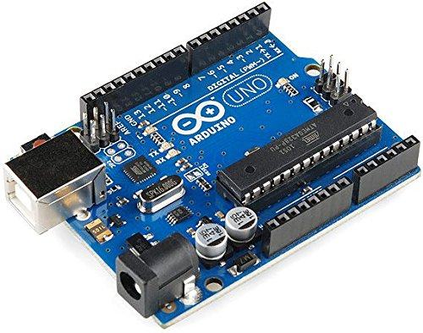
Arduino UNO
The Arduino UNO board has a list of several hardware components and has the capability to interact with those devices.
The main use of the Arduino UNO board over other Arduino board is the price factor. The price of this board is lowest compared to other Arduino products.

Slide 8
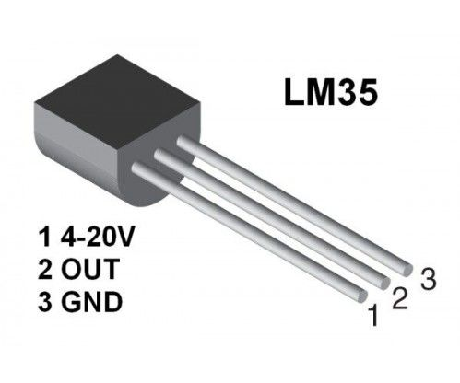
LM35: The LM35 series are precision integrated-circuit temperature sensors, whose output voltage is linearly proportional to the Celsius (Centigrade) temperature
Features
Equation to convert reading into (°C):
Calibrated directly in ˚ Celsius (Centigrade)
Linear + 10.0 mV/˚C scale factor
0.5˚C accuracy ensured (at +25˚C)
Rated for full −55˚ to +150˚C range
Suitable for remote applications
Low cost due to wafer-level trimming
Operates from 4 to 30 volts
Temperature (°C) = VOUT / 10
With VOUT in millivolt (mV). So if the output of the sensor is 750 mV, the temperature is 75°C

Slide 9
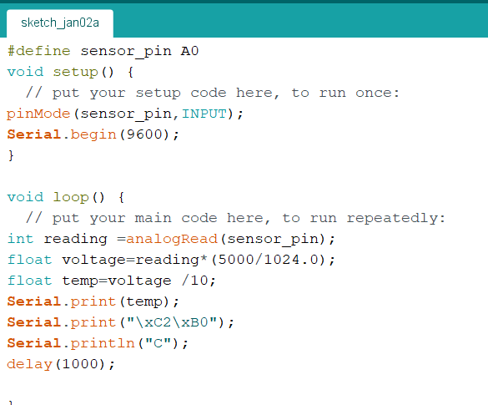
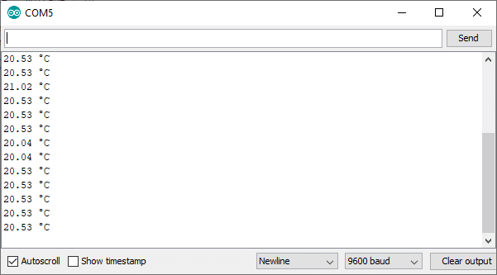
Simple code for LM35
Output :

Slide 10
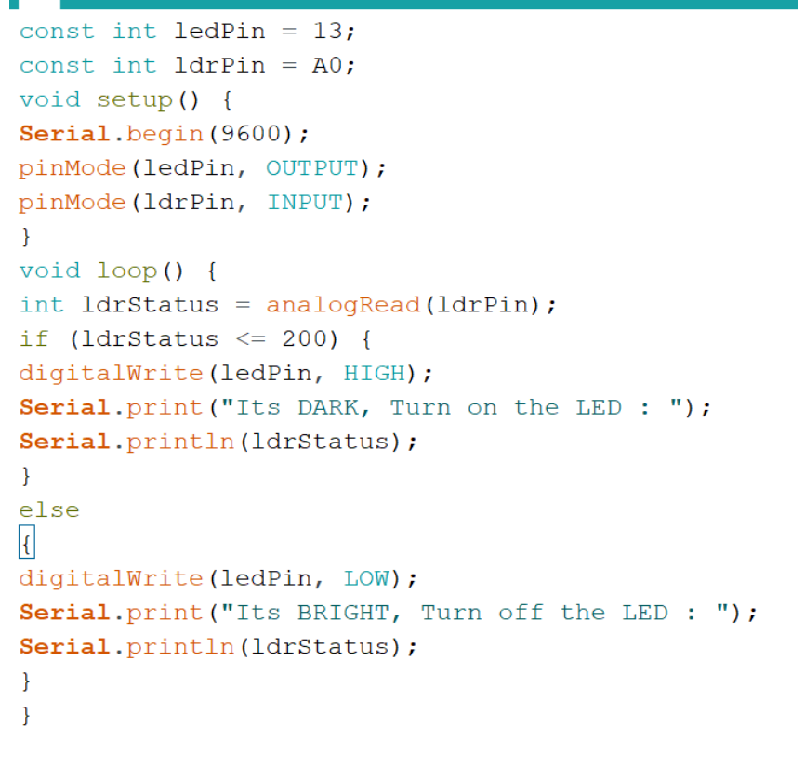
LDR
Instructions
Simple code
Connect the 3.3v output of the Arduino to the positive rail of the breadboard
Connect the ground to the negative rail of the breadboard o Place the LDR on the breadboard o Attach the 10K resistor to one of the legs of the LDR o Connect the A0 pin of the Arduino to the same column where the LDR and resistor is connected (Since the LDR gives out an analog voltage, it is connected to the analog input pin on the Arduino. The Arduino, with its built-in ADC (Analog to Digital Converter), then converts the analog voltage from 0-5V into a digital value in the range of 0-1023). - Now connect the other end of the 10K resistor to the negative rail
And the second (free) leg of the LDR to the positive rail

Slide 11
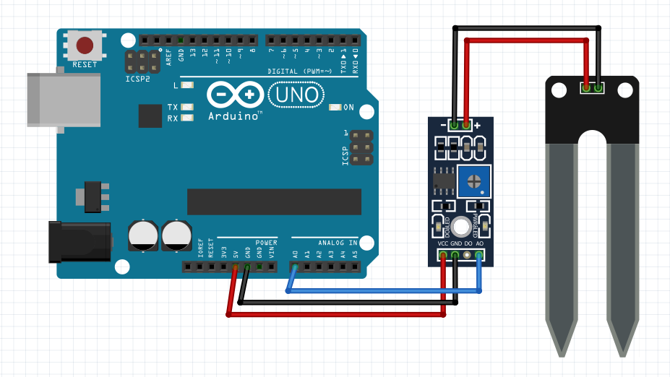
Soil moisture sensor
Operation
The Soil Moisture Sensor measures soil moisture grace to the changes in electrical conductivity of the earth (soil resistance increases with drought).
The electrical resistance is measured between the two electrodes of the sensor.
A comparator activates a digital output when a adjustable threshold is exceeded

Slide 12
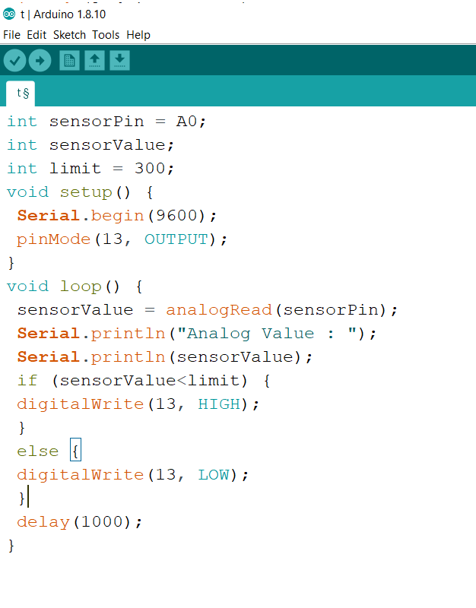
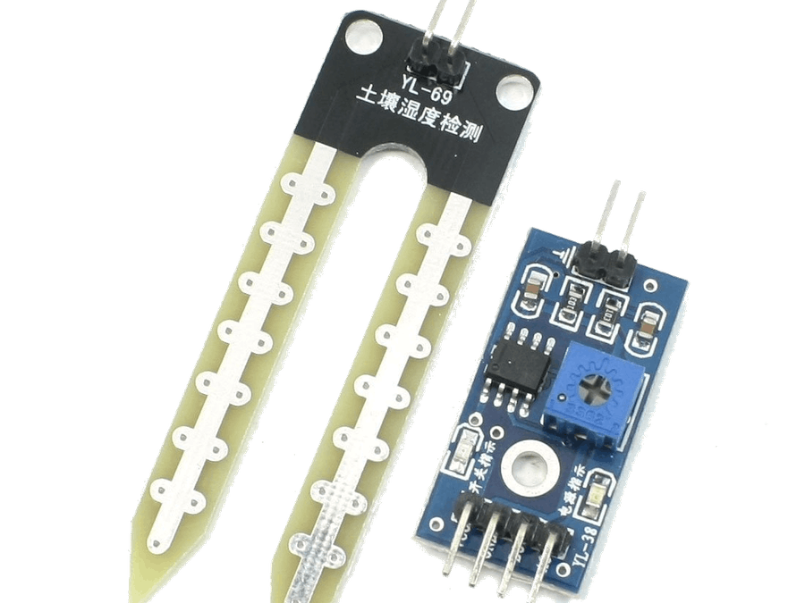
Simple code for moisture sensor
Moisture sensor

Slide 13
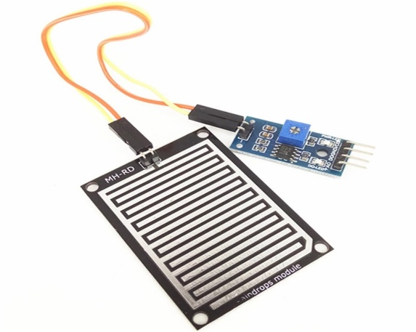
Rain sensor Rain sensor is one kind of switching device which is used to detect the rainfall. It works like a switch and the working principle of this sensor is, whenever there is rain, the switch will be normally closed.
Pin configuration
Specifications
Pin1 (VCC): It is a 5V DC pin •
Pin2 (GND): it is a GND (ground) pin
Pin3 (DO): It is a low/ high output pin
Pin4 (AO): It is an analog output pin
Anti-conductivity & oxidation with long time use
The area of this sensor includes 5cm x 4cm and can be built with a nickel plate on the side
The sensitivity can be adjusted by a potentiometer
The required voltage is 5V
The size of the small PCB is 3.2cm x 1.4cm
It uses an LM393 comparator with wide voltage
The output of the comparator is a clean waveform and driving capacity is above 15mA

Slide 14
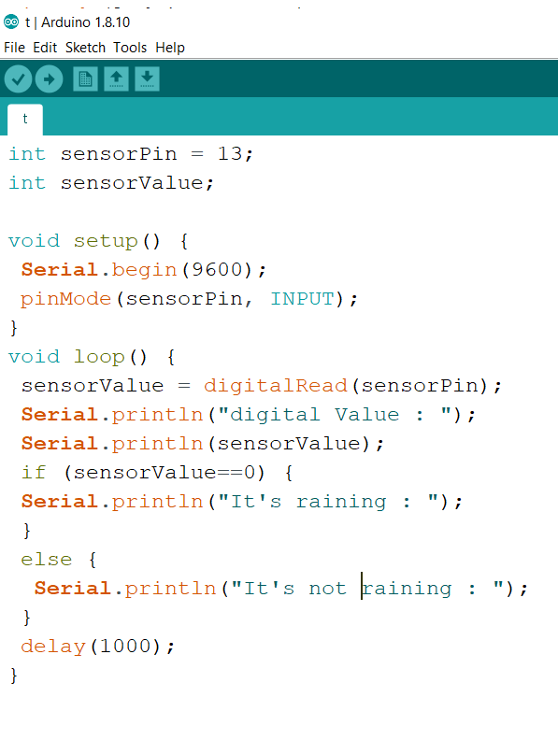
Simple code for rain sensor

Slide 15
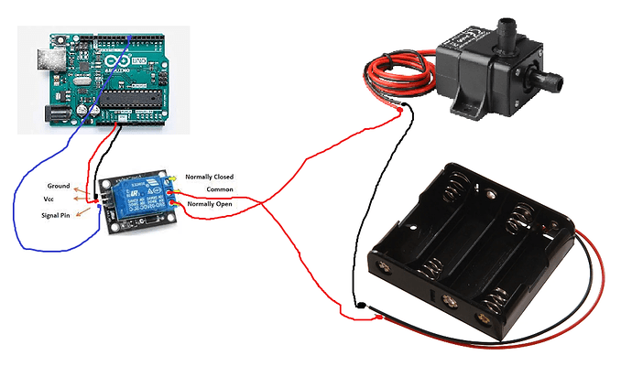
Pump
features
How to control pump?
Input Voltage: DC 3V-5V
Flow Rate: 1.2-1.6 L/min
Operation Temperature: 80 Degree C
Operating Current: 0.1-0.2A
Suction Distance: 0.8 meter (Max)
Outside diameter of water outlet: 7.5mm
Inside diameter of water outlet: 5.0 mm
Rubber tube length: 1 meter
Size: 45 x 30 x 25 mm
To control pump we need to use a relay between pump and arduino.

Slide 16
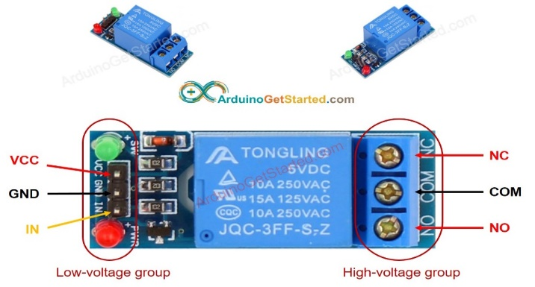
What is the difference between controlling LED and controlling pump?
In LED: we can use power from arduino (<= 5v), therefore we can connect LED directly to arduino pin
In pump: we use power source (high voltage –high current), which can burn arduino, therefore we can’t connect pump directly with arduino pin .we need to use relay between pump and arduino’s pin to protect from high voltage / current.
Lean more about relay with arduino: https://arduinogetstarted.com/tutorials/arduino-relay

Slide 17
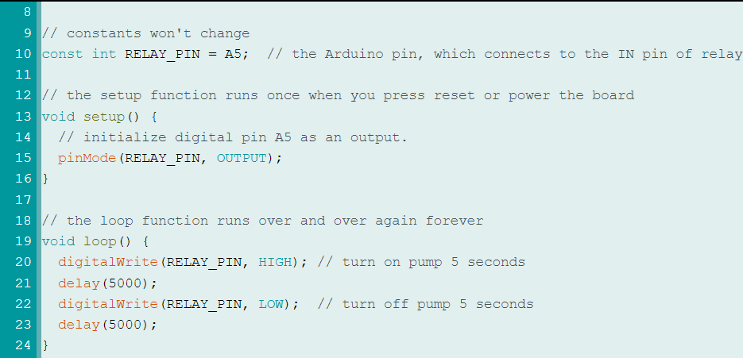
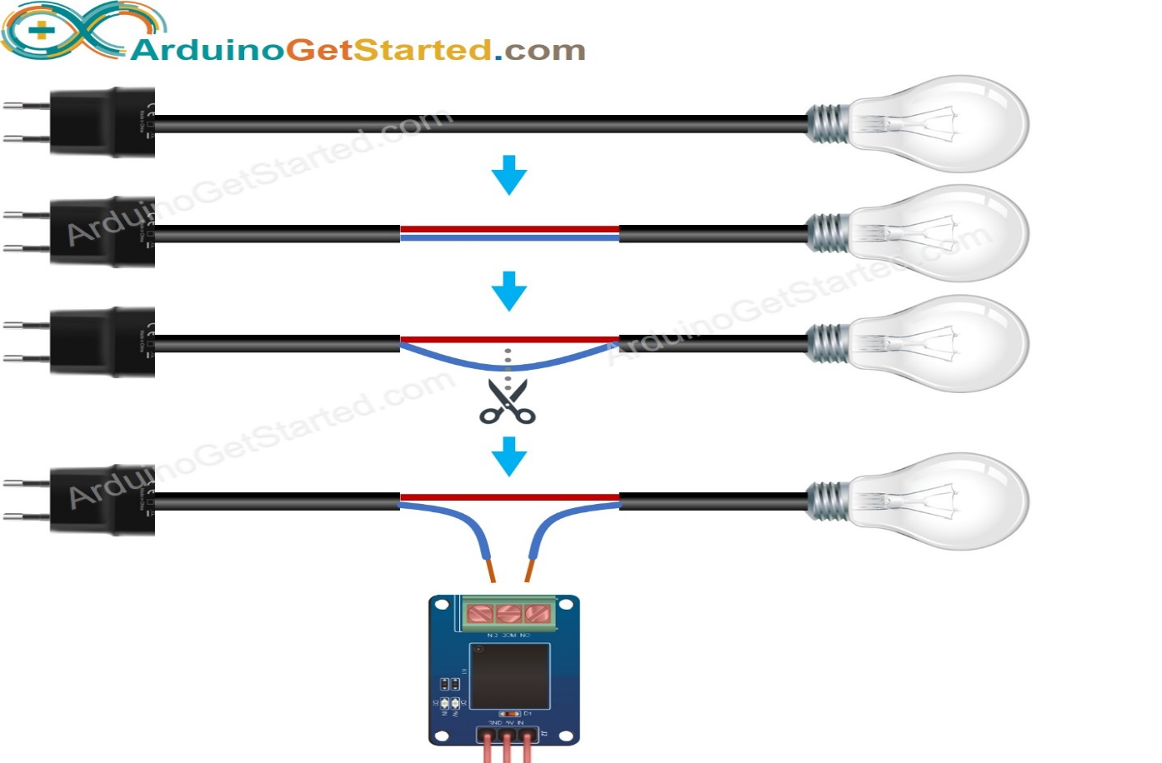
Code for pump

Slide 18
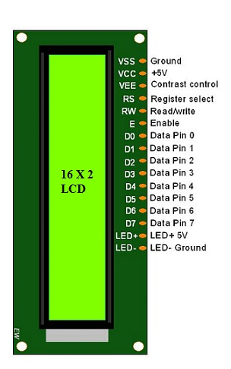
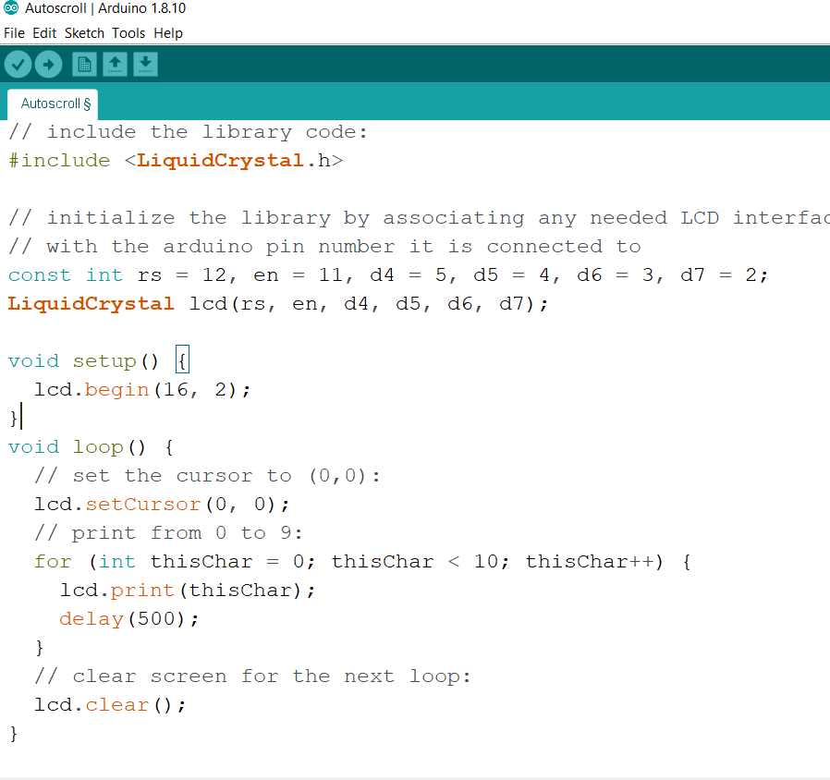
LCD
Pin configuration
Code for LCD

Slide 19
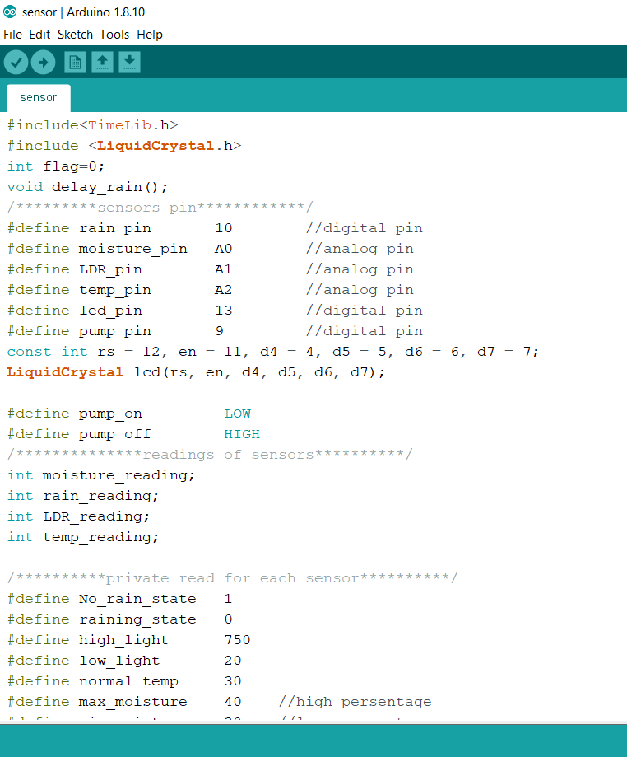
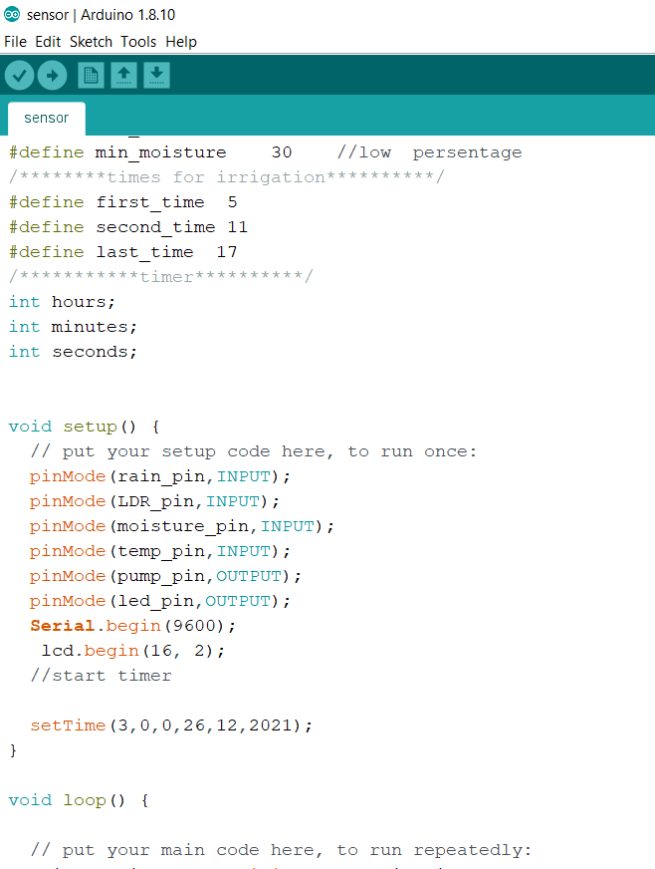
Final code

Slide 20
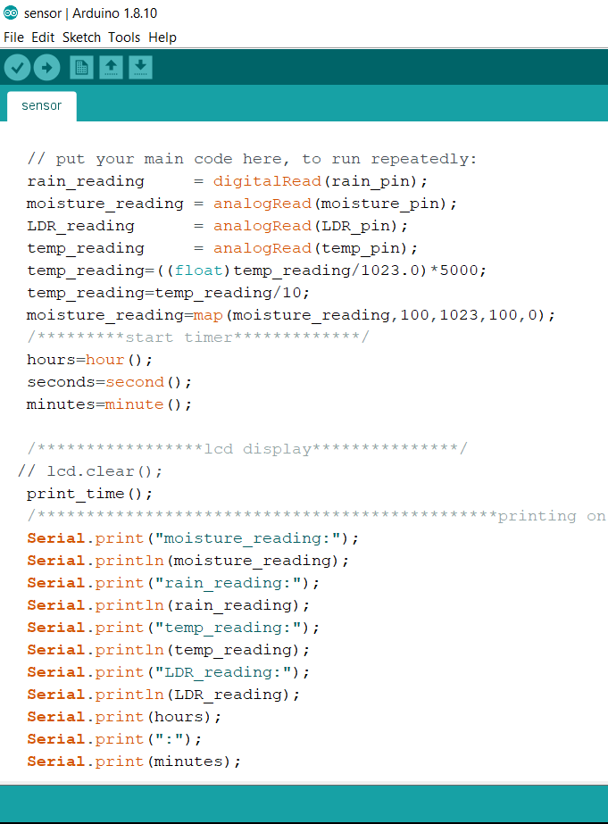
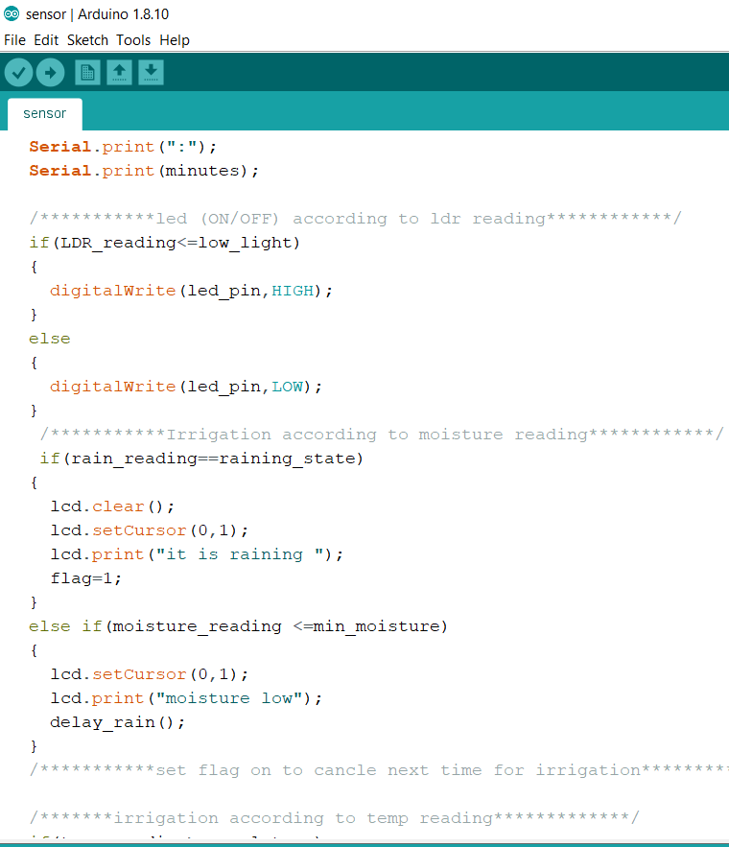

Slide 21
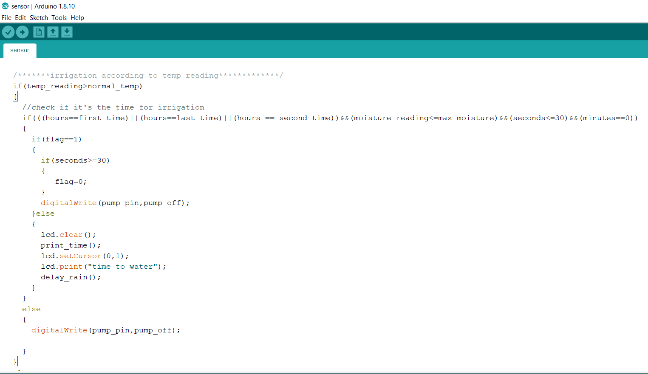
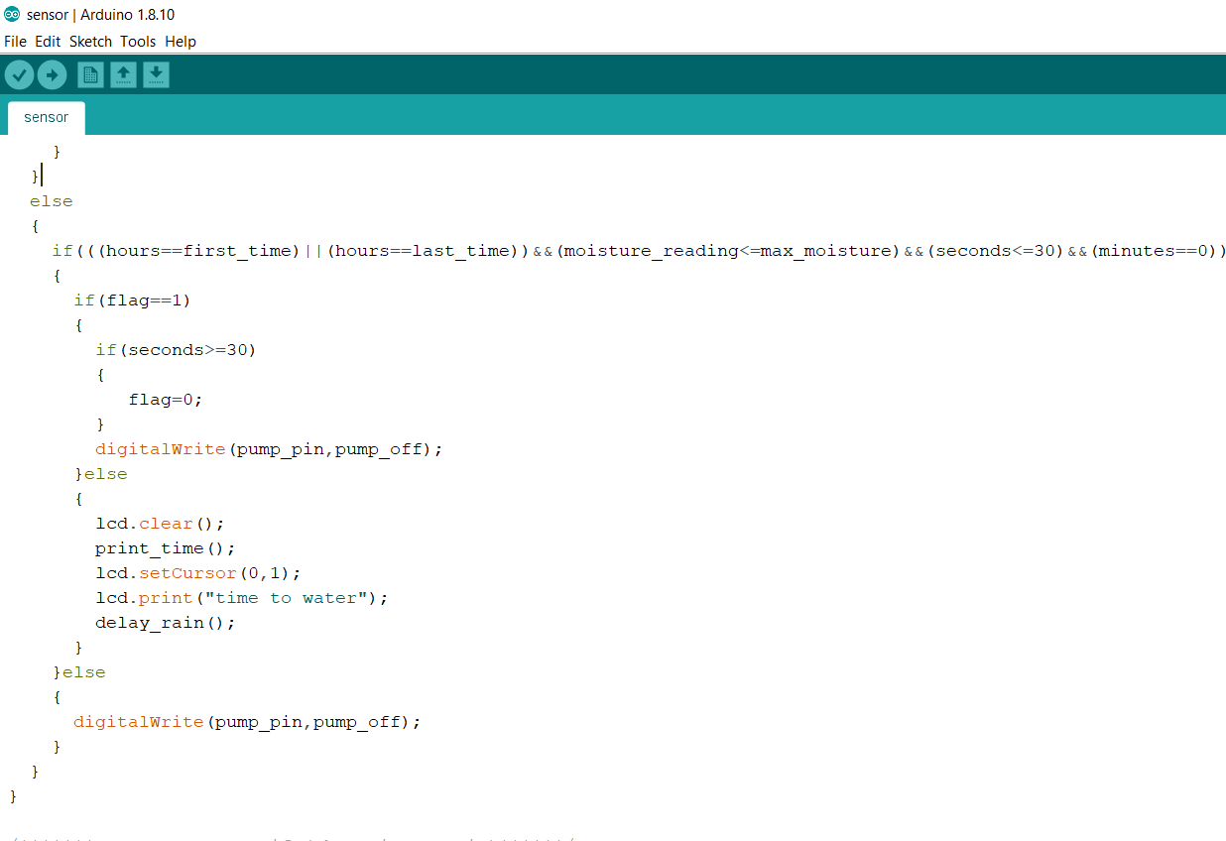

Slide 22
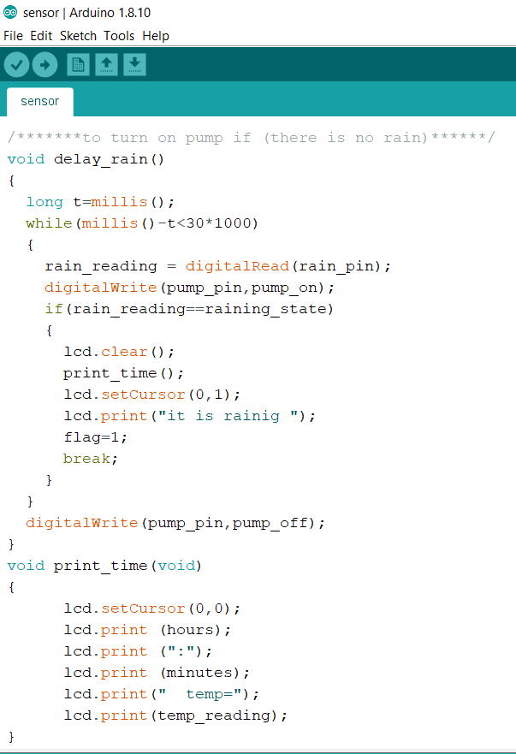

Slide 23
Team member
Prepared by :
Ahmed Shaker
Osama Salah
Osama Zidan
Osama Elzekred
Hassan Mahmoud
Mohamed Nasr
Basma Wasfy
Amira Samy
Eman Elsayed

Slide 24
Thank you

